Slide 1
Object Oriented Programming(Java) Lecture-05-06

Slide 2
Content
Java Class.
Java Objects.
Example: Java Class and Objects.
Java Methods.
Java Constructors.

Slide 3
Java Class and Object :
A class is a user defined blueprint or prototype from which objects are created.
Java Class represents the set of properties or methods that are common to all objects of one type.

Slide 4
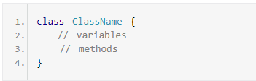
Structure of Java Class:

Slide 5
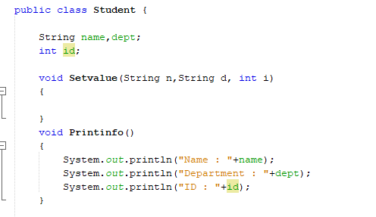
Example: Java Class

Slide 6
Structure : Java Object
// creating object of a class
Class_Name Obj_Name = new Class_Name ();

Slide 7
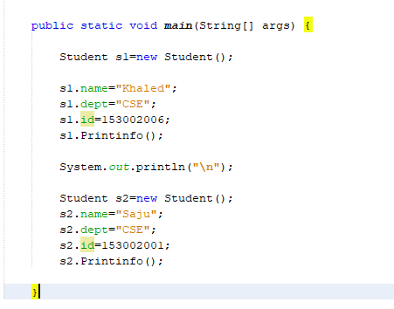
Example: Java Object

Slide 8
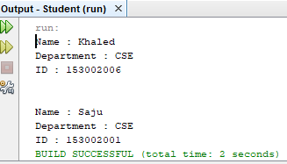
Example: Java Class & Object(Contd.)

Slide 9
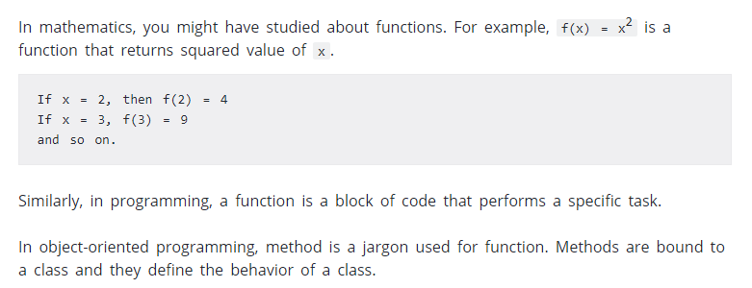
Java Methods :

Slide 10
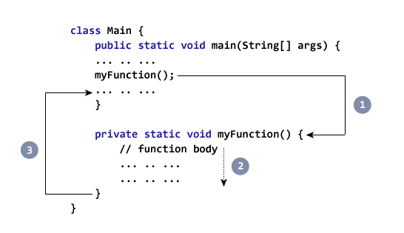
Call Java Methods:

Slide 11
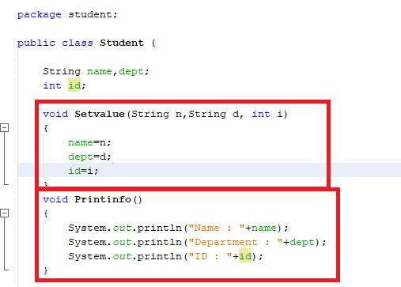
Example :Java Methods

Slide 12
Java Constructors :
A constructor is similar to a method (but not actually a method) that is invoked automatically when an object is instantiated.

Slide 13
Features of Constructors :
Special type of Method
No return type.
invoked automatically.
Same as Class Name.

Slide 14
Structure :Java Constructors
Constructor_Name ()
{
}
Or
Constructor_Name (Parameter)
{
}

Slide 15
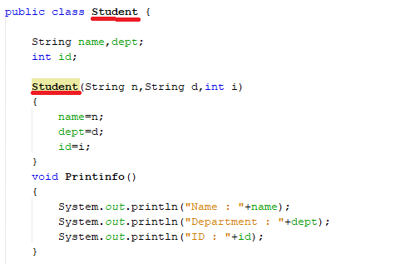
Example :Java Constructors

Slide 16

Example :Java Constructors(Contd.)

Slide 17
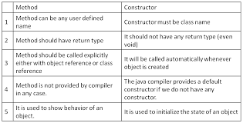
Difference b/w Methods & Constructor :

Slide 18
Thanks

